Slide 1
Please view as slideshow to enjoy timed slides with audio presentation. Thank you.
NOTE: If prompted, please “enable editing”.

Slide 2
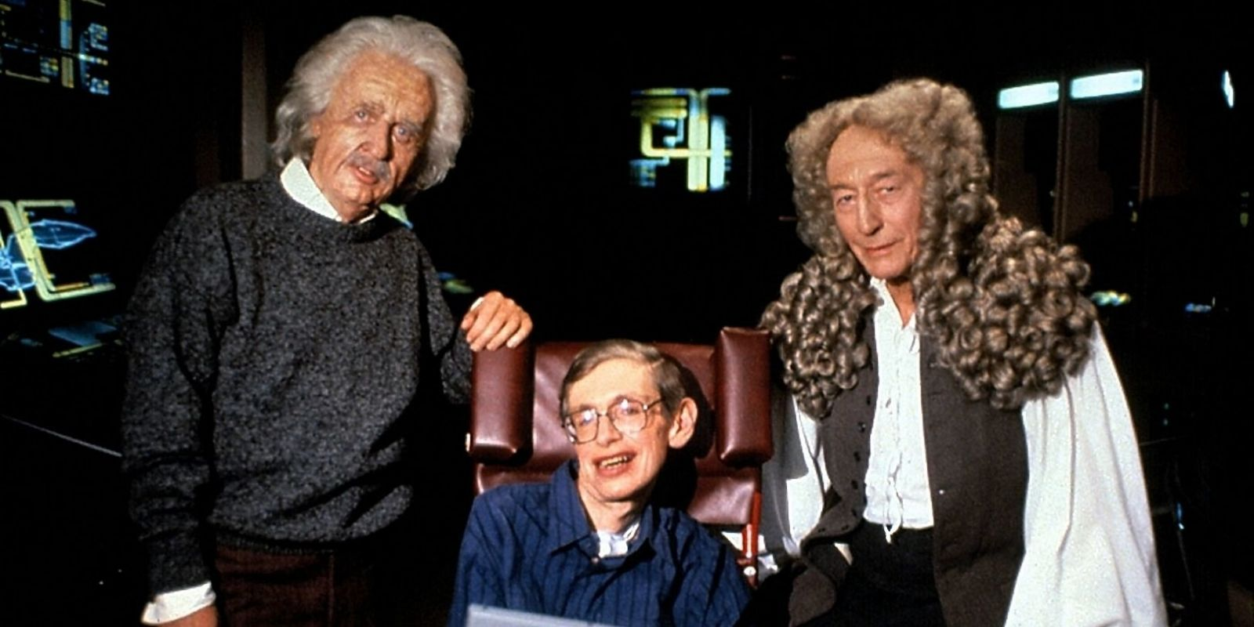

Slide 3
Theistic Science
2060

Slide 4
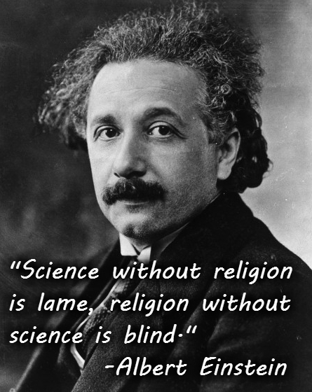
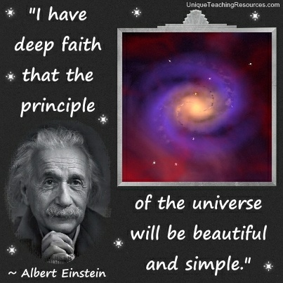
Agnostic Science

Slide 5
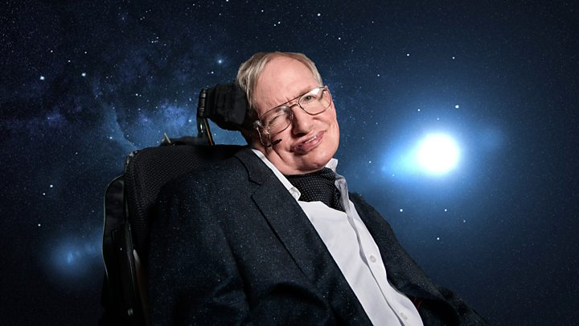
Atheistic Science
In the beginning… there was nothing

Slide 7
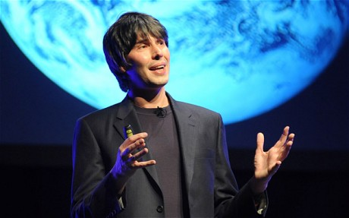
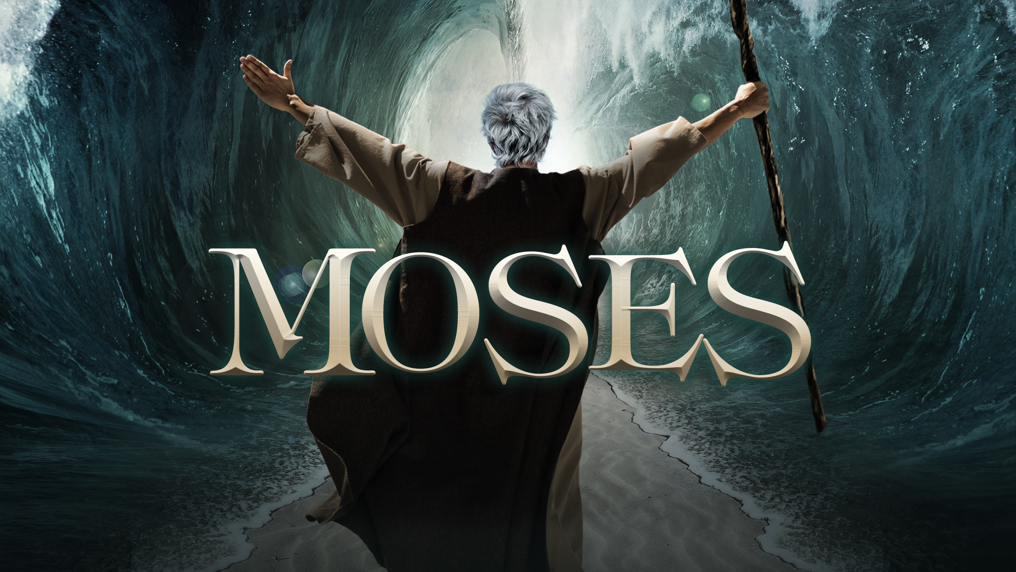
Statements of Faith (not fact):
‘In the beginning there was nothing…’
Brian Cox
‘In the beginning God…’
Genesis

Slide 8
Statements of Faith (not fact):
‘In the beginning there was nothing…’
Underlying principle: something came from nothing
‘In the beginning God…’
Underlying principle: something came from something

Slide 9
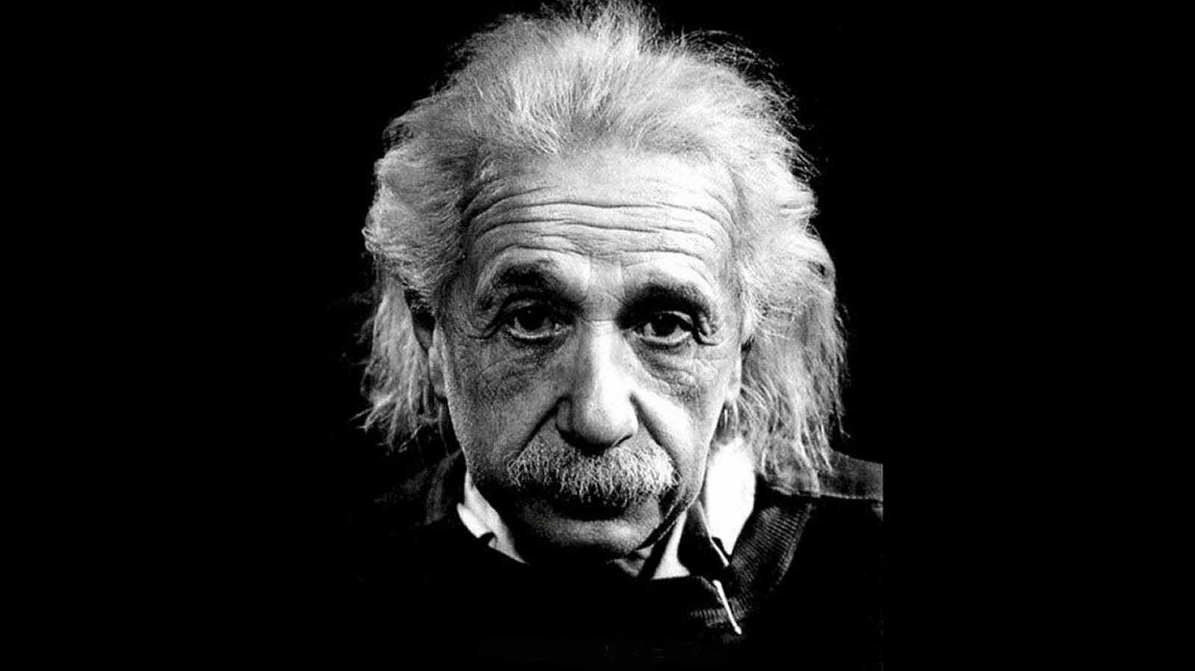
Agnostic Science
Theistic Science
Atheistic Science

Slide 10
Agnostic Science
Theistic Science
Atheistic Science
God as non-personal ‘Mind/Being’
God as ‘Person’
God does not exist
All based on belief rather than evidence

Slide 11
Agnostic Science
Theistic Science
Atheistic Science
God as non-personal ‘Mind/Being’
God as ‘Person’
God does not exist
‘spirit’ religion
‘spirit & matter’ religion
‘matter’ religion

Slide 12
What is the ultimate nature of reality (our eternal destiny)?
Spirit
Spirit & Matter
Matter
Each of these 3 give a different perspective on origins, and then follow a logical narrative/story to the end

Slide 13
Spirit
Spirit & Matter
Matter

Slide 14
Spirit
Spirit & Matter
Matter
‘spiritism’
‘intermingled’
‘materialism’

Slide 15
Spirit
Spirit & Matter
Matter
‘spiritism’
‘intermingled’
‘materialism’
spirit/mind is eternal – no beginning and no end
Both spirit/mind and matter were created in the beginning – not eternal
Matter was created at the beginning; spirit/mind does not exist, only brain

Slide 16
Spirit
Spirit & Matter
Matter
‘spiritism’
‘intermingled’
‘materialism’
spirit/mind is eternal – no beginning and no end
Both spirit/mind and matter were created in the beginning – not eternal
Matter was created at the beginning; spirit/mind does not exist, only brain
Purpose of life – to escape from the prison of body/matter and release the spirit into a non-material, non-personal realm
Purpose of life – to relate to a personal God
No purpose to life

Slide 17
Spirit
Spirit & Matter
Matter
‘spiritism’
‘intermingled’
‘materialism’
spirit/mind is eternal – no beginning and no end
Both spirit/mind and matter were created in the beginning – not eternal
Matter was created at the beginning; spirit/mind does not exist, only brain
Purpose of life – to escape from the prison of body/matter and release the spirit into a non-material, non-personal realm
Purpose of life – to relate to a personal God
No purpose to life
Physical death – end of the person; spirit/soul fuses into the eternal, impersonal mind/being
Physical death – followed by judgment and physical resurrection – the person is still there
Physical death – end of the person – when the brain dies only decomposed molecules and atoms are left

Slide 18
Spirit
Spirit & Matter
Matter
‘spiritism’
‘intermingled’
‘materialism’
spirit/mind is eternal – no beginning and no end
Both spirit/mind and matter were created in the beginning – not eternal
Matter was created at the beginning; spirit/mind does not exist, only brain
All 3 perspectives are based on faith rather than evidence
Purpose of life – to escape from the prison of body/matter and release the spirit into a non-material, non-personal realm
Purpose of life – to relate to a personal God
No purpose to life
Physical death – end of the person; spirit/soul fuses into the eternal, impersonal mind/being
Physical death – followed by judgment and physical resurrection – the person is still there
Physical death – end of the person – when the brain dies only decomposed molecules and atoms are left

Slide 19
Spirit
Spirit & Matter
Matter
‘spiritism’
‘intermingled’
‘materialism’
spirit/mind is eternal – no beginning and no end
Both spirit/mind and matter were created in the beginning – not eternal
Matter was created at the beginning; spirit/mind does not exist, only brain
No evidence regarding the origins, beginning; no eye-witnesses; everything is primordial, prehistoric, and non verifiable
Purpose of life – to escape from the prison of body/matter and release the spirit into a non-material, non-personal realm
No purpose to life
Purpose of life – to relate to a personal God
Physical death – end of the person; spirit/soul fuses into the eternal, impersonal mind/being
Physical death – followed by judgment and physical resurrection – the person is still there
Physical death – end of the person – when the brain dies only decomposed molecules and atoms are left

Slide 20
Spirit
Spirit & Matter
Matter
‘spiritism’
‘intermingled’
‘materialism’
spirit/mind is eternal – no beginning and no end
Both spirit/mind and matter were created in the beginning – not eternal
Matter was created at the beginning; spirit/mind does not exist, only brain
Is there any other kind of evidence suggesting that any of these perspectives may be true?
Purpose of life – to escape from the prison of body/matter and release the spirit into a non-material, non-personal realm
Purpose of life – to relate to a personal God
No purpose to life
Physical death – end of the person; spirit/soul fuses into the eternal, impersonal mind/being
Physical death – followed by judgment and physical resurrection – the person is still there
Physical death – end of the person – when the brain dies only decomposed molecules and atoms are left

Slide 21
Spirit
Spirit & Matter
Matter
‘spiritism’
‘intermingled’
‘materialism’
spirit/mind is eternal – no beginning and no end
Both spirit/mind and matter were created in the beginning – not eternal
Matter was created at the beginning; spirit/mind does not exist, only brain
There is only one instance where there is some historical, verifiable evidence; not regarding the beginning of life but the end of life
Purpose of life – to escape from the prison of body/matter and liberate the spirit into a non-material, non-personal realm
Purpose of life – to live in a body and relate to a personal God
No purpose to life
Physical death – end of the person; spirit/soul fuses into the eternal, impersonal mind/being
Physical death – followed by judgment and physical resurrection – the person is still there
Physical death – end of the person – when the brain dies only decomposed molecules and atoms are left

Slide 22
Spirit
Spirit & Matter
Matter
‘spiritism’
‘intermingled’
‘materialism’
spirit/mind is eternal – no beginning and no end
Both spirit/mind and matter were created in the beginning – not eternal
Matter was created at the beginning; spirit/mind does not exist, only brain
Purpose of life – to escape from the prison of body/matter and liberate the spirit into a non-material, non-personal realm
Purpose of life – to enjoy life in a body within the context of God’s will; to relate to others, and to relate to a personal God
No purpose to life
Physical death – followed by physical resurrection – the person is still there
Physical death – end of the person; spirit/soul fuses into the eternal, impersonal mind/being
Physical death – end of the person – when the brain dies only decomposed molecules and atoms are left

Slide 23
Spirit
Spirit & Matter
Matter
‘spiritism’
‘intermingled’
Marx is gone
Lenin is gone
Buddha is gone
Einstein is gone
‘materialism’
spirit/mind is eternal – no beginning and no end
Both spirit/mind and matter were created in the beginning – not eternal
Matter was created at the beginning; spirit/mind does not exist, only brain
Purpose of life – to escape from the prison of body/matter and liberate the spirit into a non-material, non-personal realm
Purpose of life – to enjoy life in a body within the context of God’s will; to relate to others, and to relate to a personal God
No purpose to life
Physical death – followed by physical resurrection – the person is still there
Physical death – end of the person; spirit/soul fuses into the eternal, impersonal mind/being
Physical death – end of the person – when the brain dies only decomposed molecules and atoms are left

Slide 24
Spirit
Spirit & Matter
Matter
Rabbis are gone
Mohammad is gone
‘spiritism’
‘intermingled’
Marx is gone
Lenin is gone
Buddha is gone
Einstein is gone
‘materialism’
spirit/mind is eternal – no beginning and no end
Both spirit/mind and matter were created in the beginning – not eternal
Matter was created at the beginning; spirit/mind does not exist, only brain
Purpose of life – to escape from the prison of body/matter and liberate the spirit into a non-material, non-personal realm
Purpose of life – to live in a body and relate to a personal God
No purpose to life
Physical death – followed by physical resurrection – the person is still there
Physical death – end of the person; spirit/soul fuses into the eternal, impersonal mind/being
Physical death – end of the person – when the brain dies only decomposed molecules and atoms are left

Slide 25
There is only one person who gave some evidence regarding what happens after we die
His claims are supported by the most attested ancient historical document, based on the accounts given by eyewitnesses, and written by eyewitnesses

Slide 26
"Many have undertaken to draw up an account of the things that have been fulfilled among us, just as they were handed down to us by those who from the first were eyewitnesses and servants of the word. Therefore, since I myself have carefully investigated everything from the beginning, it seemed good also to me to write an orderly account for you, most excellent Theophilus, so that you may know the certainty of the things you have been taught." (Luke 1:1-4)

Slide 27
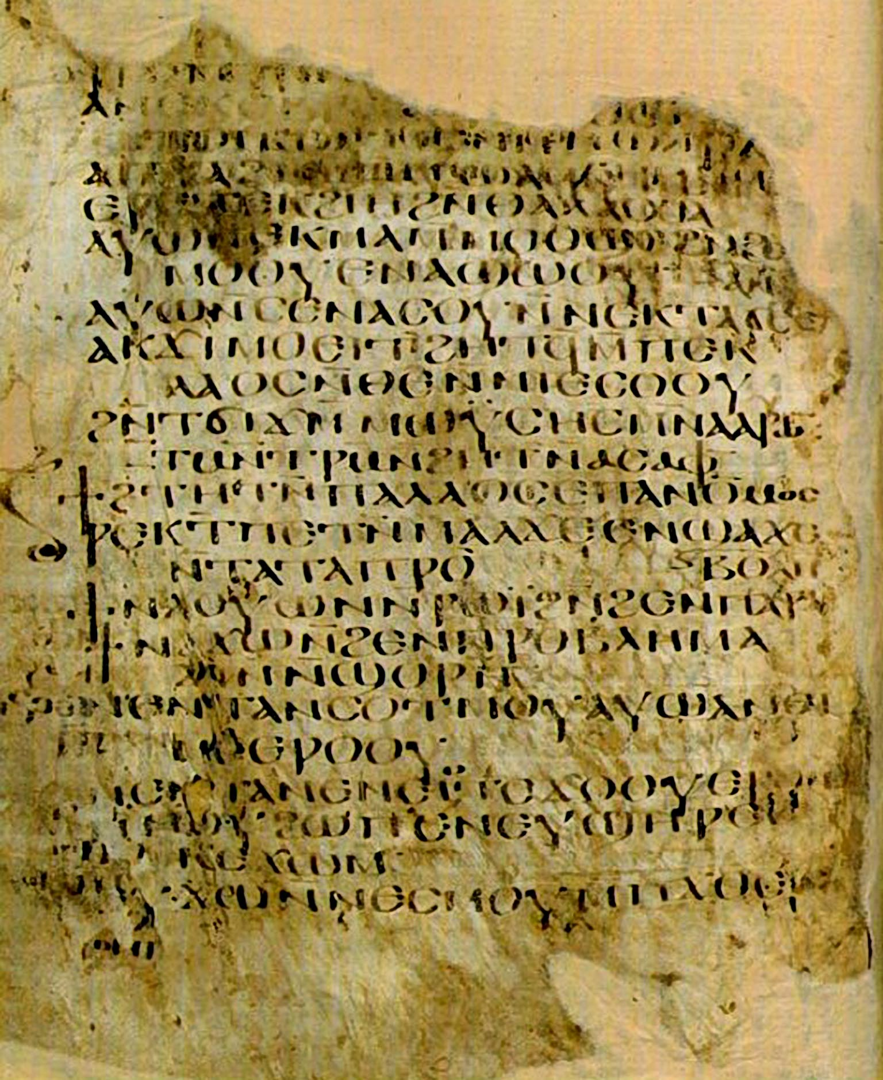
New Testament Evidence

Slide 28
Author | Date Written | Earliest Copy | Time between original & copy | Number of Copies | Accuracy of Copies
Plato | 427-347 B.C. | A.D. 900 | 1200 yrs | 7 | ----
Herodotus | 480-425 B.C. | A.D. 900 | 1300 yrs | 8 | ----
Caesar | 100-44 B.C. | A.D. 900 | 1000 | 10 | ----
Aristotle | 384-322 B.C. | A.D. 1100 | 1400 | 49 | ----
Homer (Iliad) | 900 B.C. | 400 B.C. | 500 yrs | 643 | 95%
New Testament | 1st Cent. A.D. (A.D. 50-100) | 2nd Cent. A.D. (A.D. 125) | less than 100 years | 5800+ | 99.5%

Slide 29
Parts of the New Testament have been preserved in more manuscripts than any other ancient work, having over 5,800 complete or fragmented Greek manuscripts, 10,000 Latin manuscripts and 9,300 manuscripts in various other ancient languages including Syriac, Slavic, Gothic, Ethiopic, Coptic and Armenian.
25000 +

Slide 30
Spirit
Spirit & Matter
Matter
‘spiritism’
‘intermingled’
‘materialism’
spirit/mind is eternal – no beginning and no end
Both spirit/mind and matter were created in the beginning – not eternal
Matter was created at the beginning; spirit/mind does not exist, only brain
Purpose of life – to escape from the prison of body/matter and liberate the spirit into a non-material, non-personal realm
Purpose of life – to enjoy life in a body within the context of God’s will; to relate to others, and to relate to a personal God
No purpose to life
Physical death – followed by physical resurrection – the person is still there
Physical death – end of the person; spirit/soul fuses into the eternal, impersonal mind/being
Physical death – end of the person – when the brain dies only decomposed molecules and atoms are left

Slide 31
‘Now, brothers, I want to remind you of the gospel I preached to you, which you received and on which you have taken your stand.
By this gospel you are saved, if you hold firmly to the word I preached to you. Otherwise, you have believed in vain.
For what I received I passed on to you as of first importance: that Christ died for our sins according to the Scriptures,
that he was buried, that he was raised on the third day according to the Scriptures, and that he appeared to Peter, and then to the Twelve.
After that, he appeared to more than five hundred of the brothers at the same time, most of whom are still living, though some have fallen asleep.’ 1 Corinthians 15:1-6

